Slide 1
Networking
and
Internetworking
Devices

Slide 2
An internet is an interconnection of individual networks. To create an internet, we need internetworking devices called routers and gateways.

Slide 3
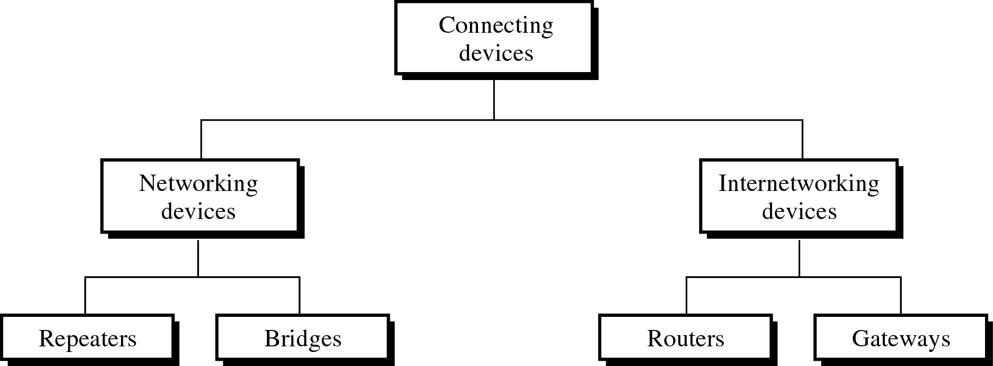
Connecting Devices

Slide 4
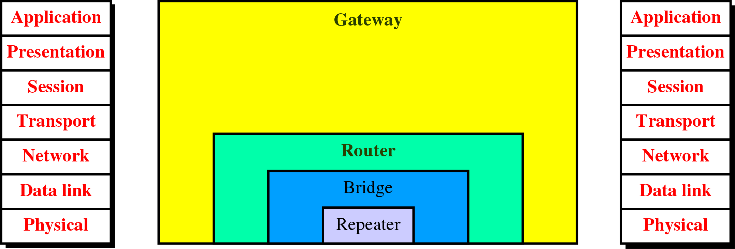
Connecting Devices and the OSI Model

Slide 5
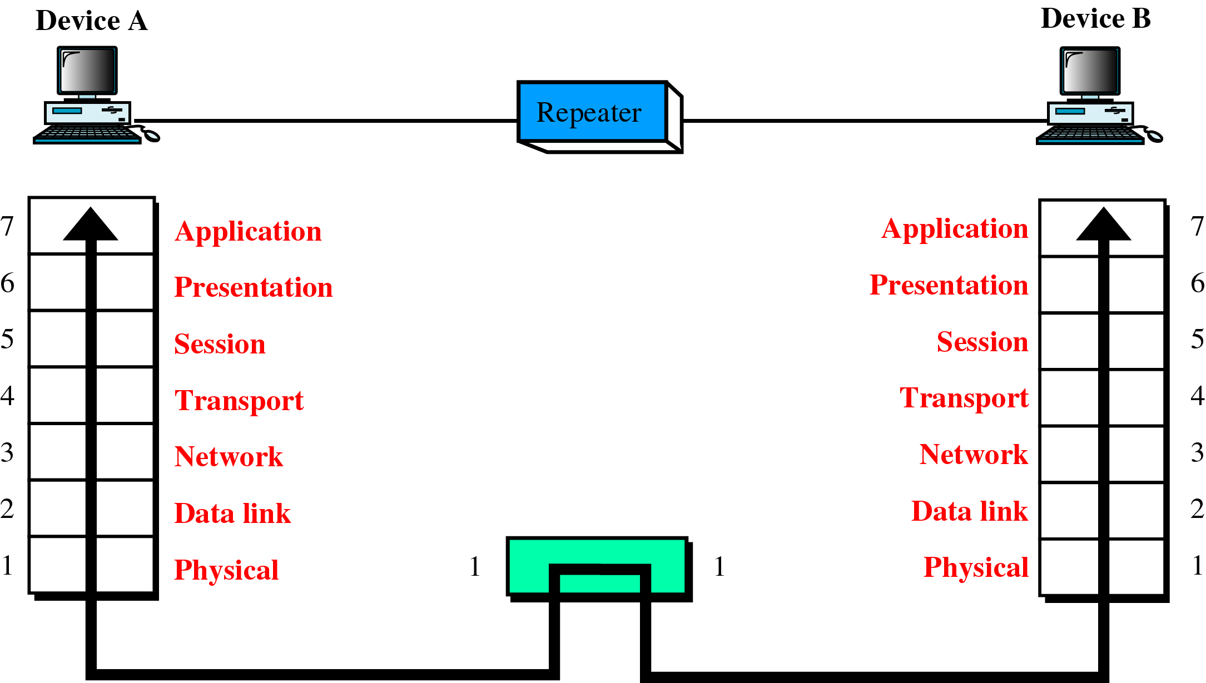
A Repeater in the OSI Model

Slide 6
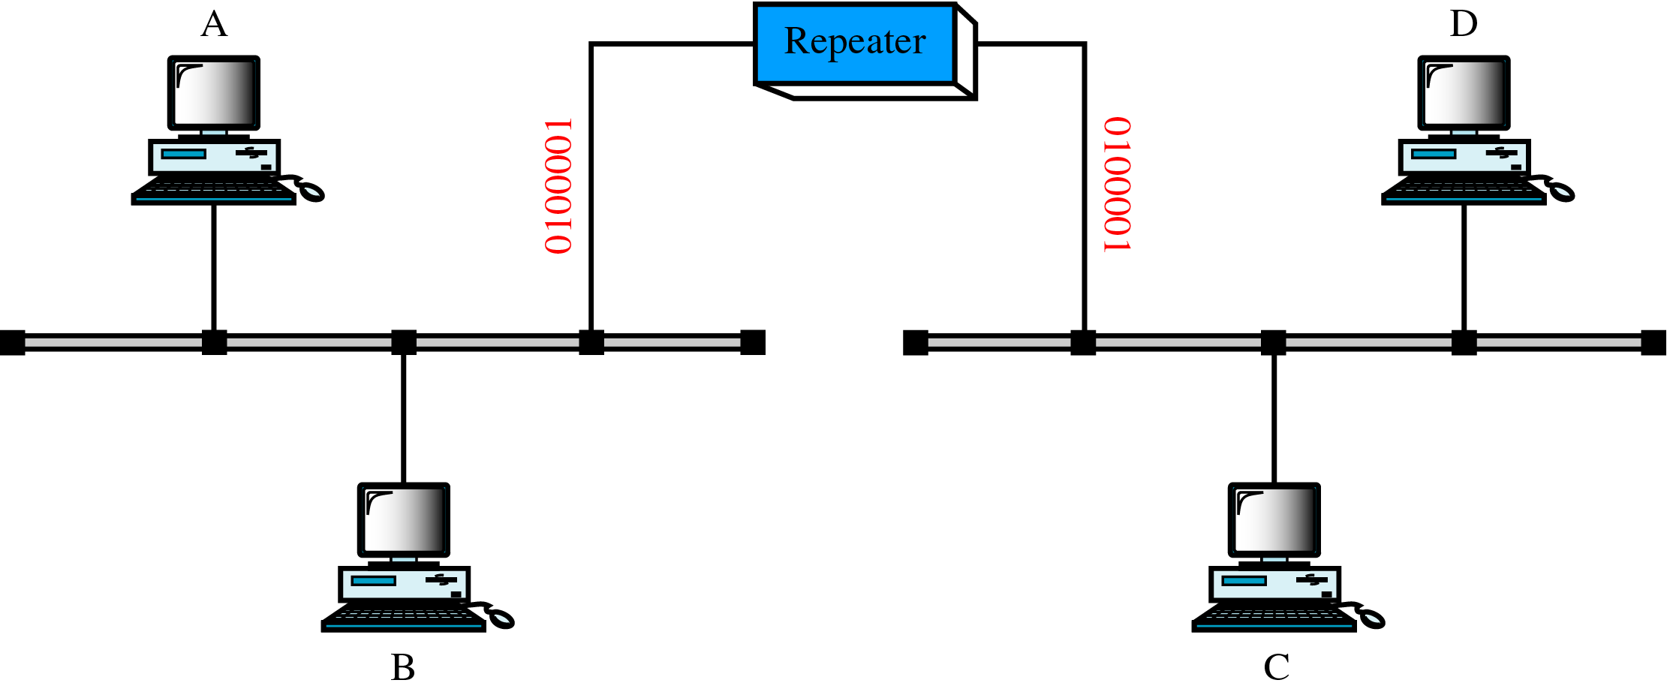
A Repeater

Slide 7
With the repeater, the destination stations receive a true copy of the frame than would otherwise have been possible. It does not have intelligence needed in routing between LANs.

Slide 8
Not an amplifier
An amplifier cannot discriminate between the intended signal and noise; it amplifies equally everything fed into it.
A repeater does not amplify the signal; it regenerates it.

Slide 9
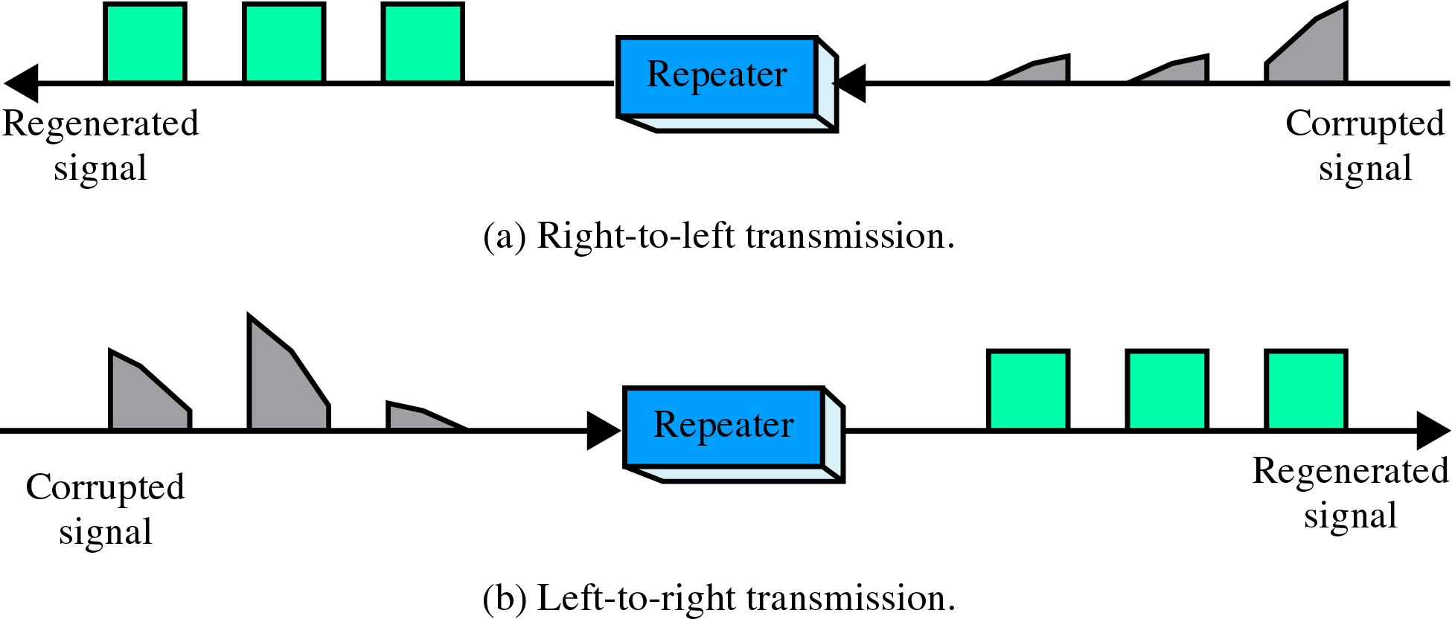
Function of a Repeater

Slide 10
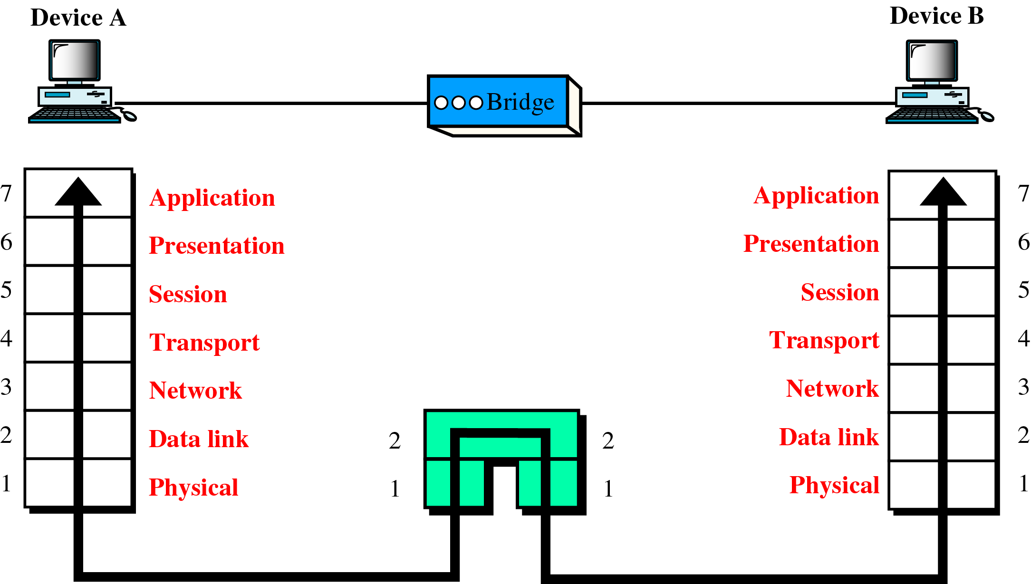
A Bridge in the OSI Model

Slide 11
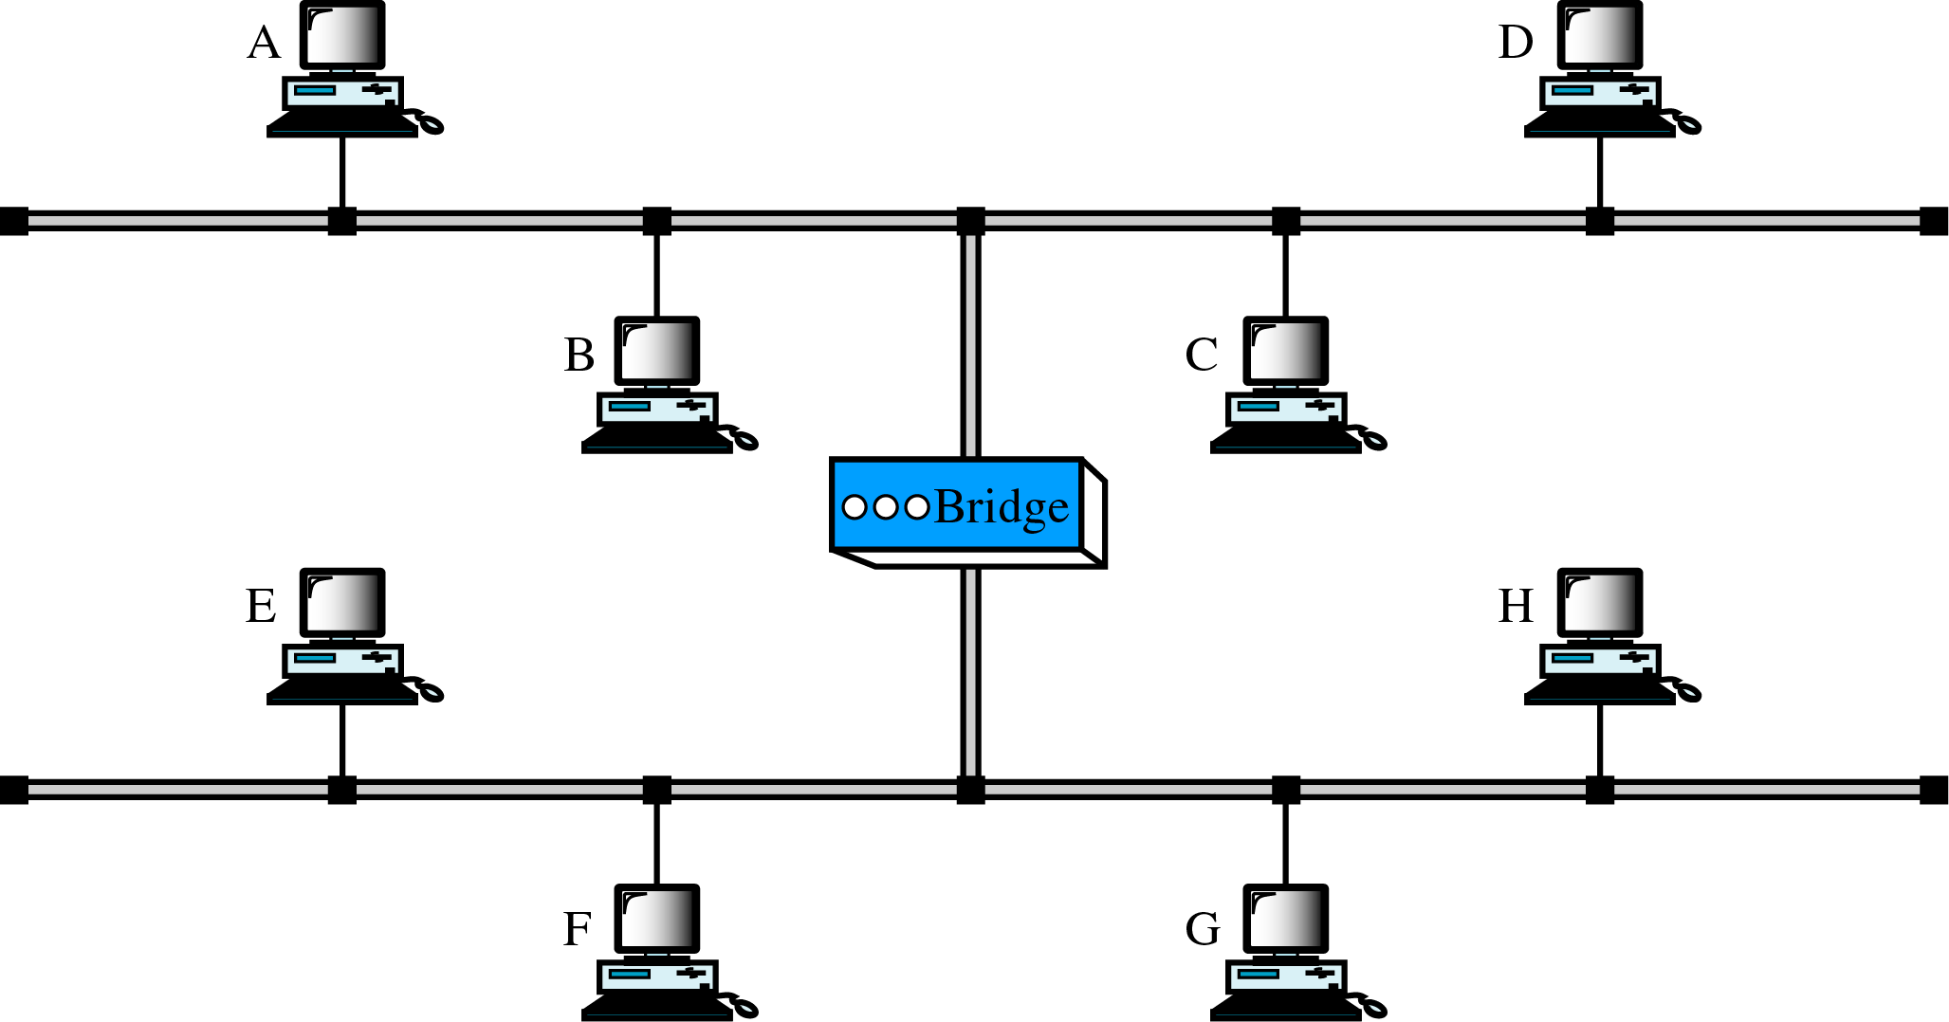
A Bridge

Slide 12
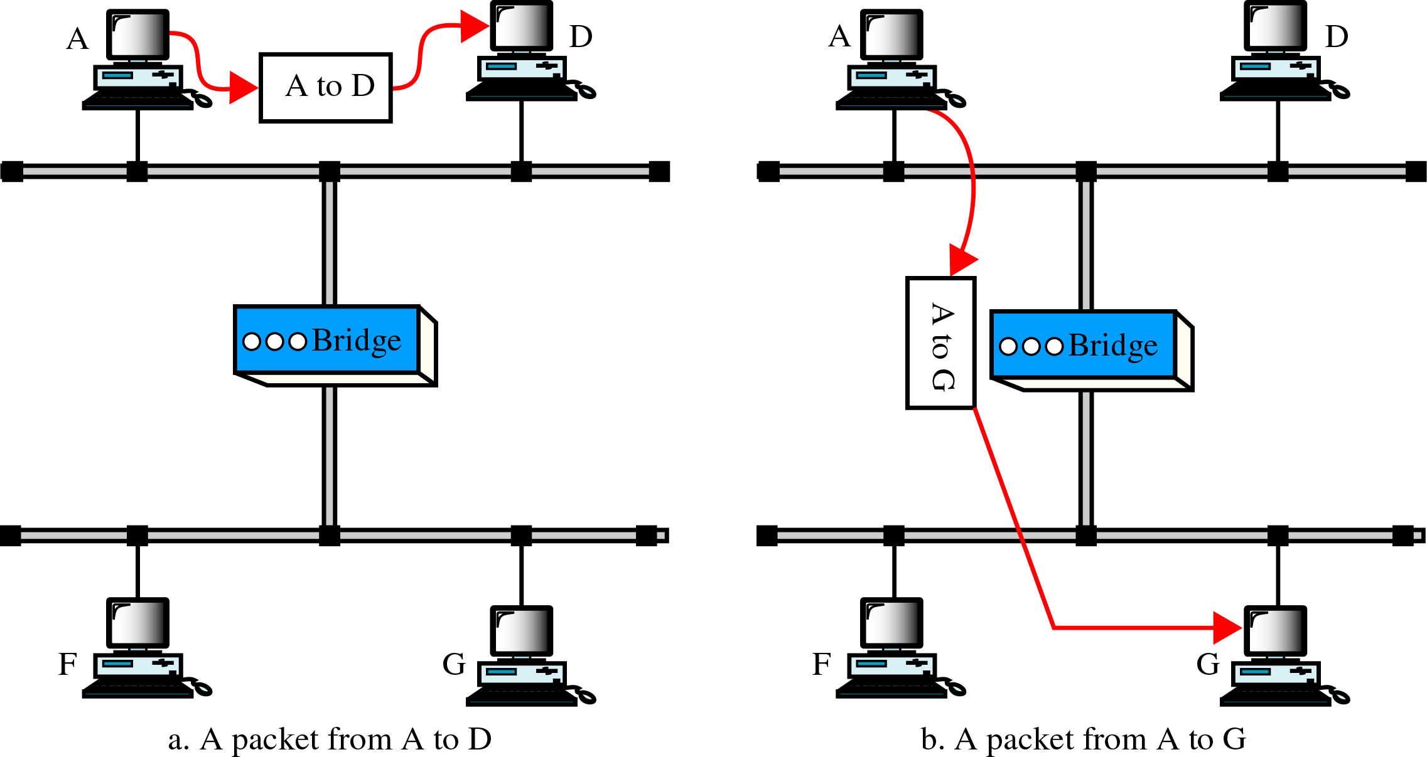
Function of a Bridge

Slide 13
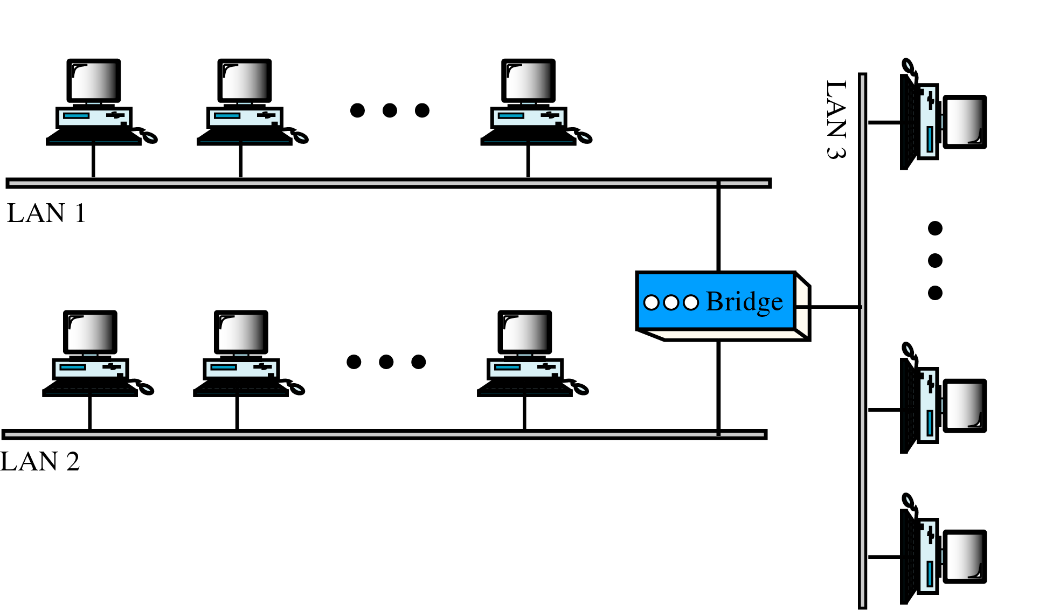
Multiport Bridge

Slide 14
Bridges connecting different LANs
Frame format
Payload size
Data rate
Address bit order
Other issues: such as acknowledgment, collision, and priority.

Slide 15
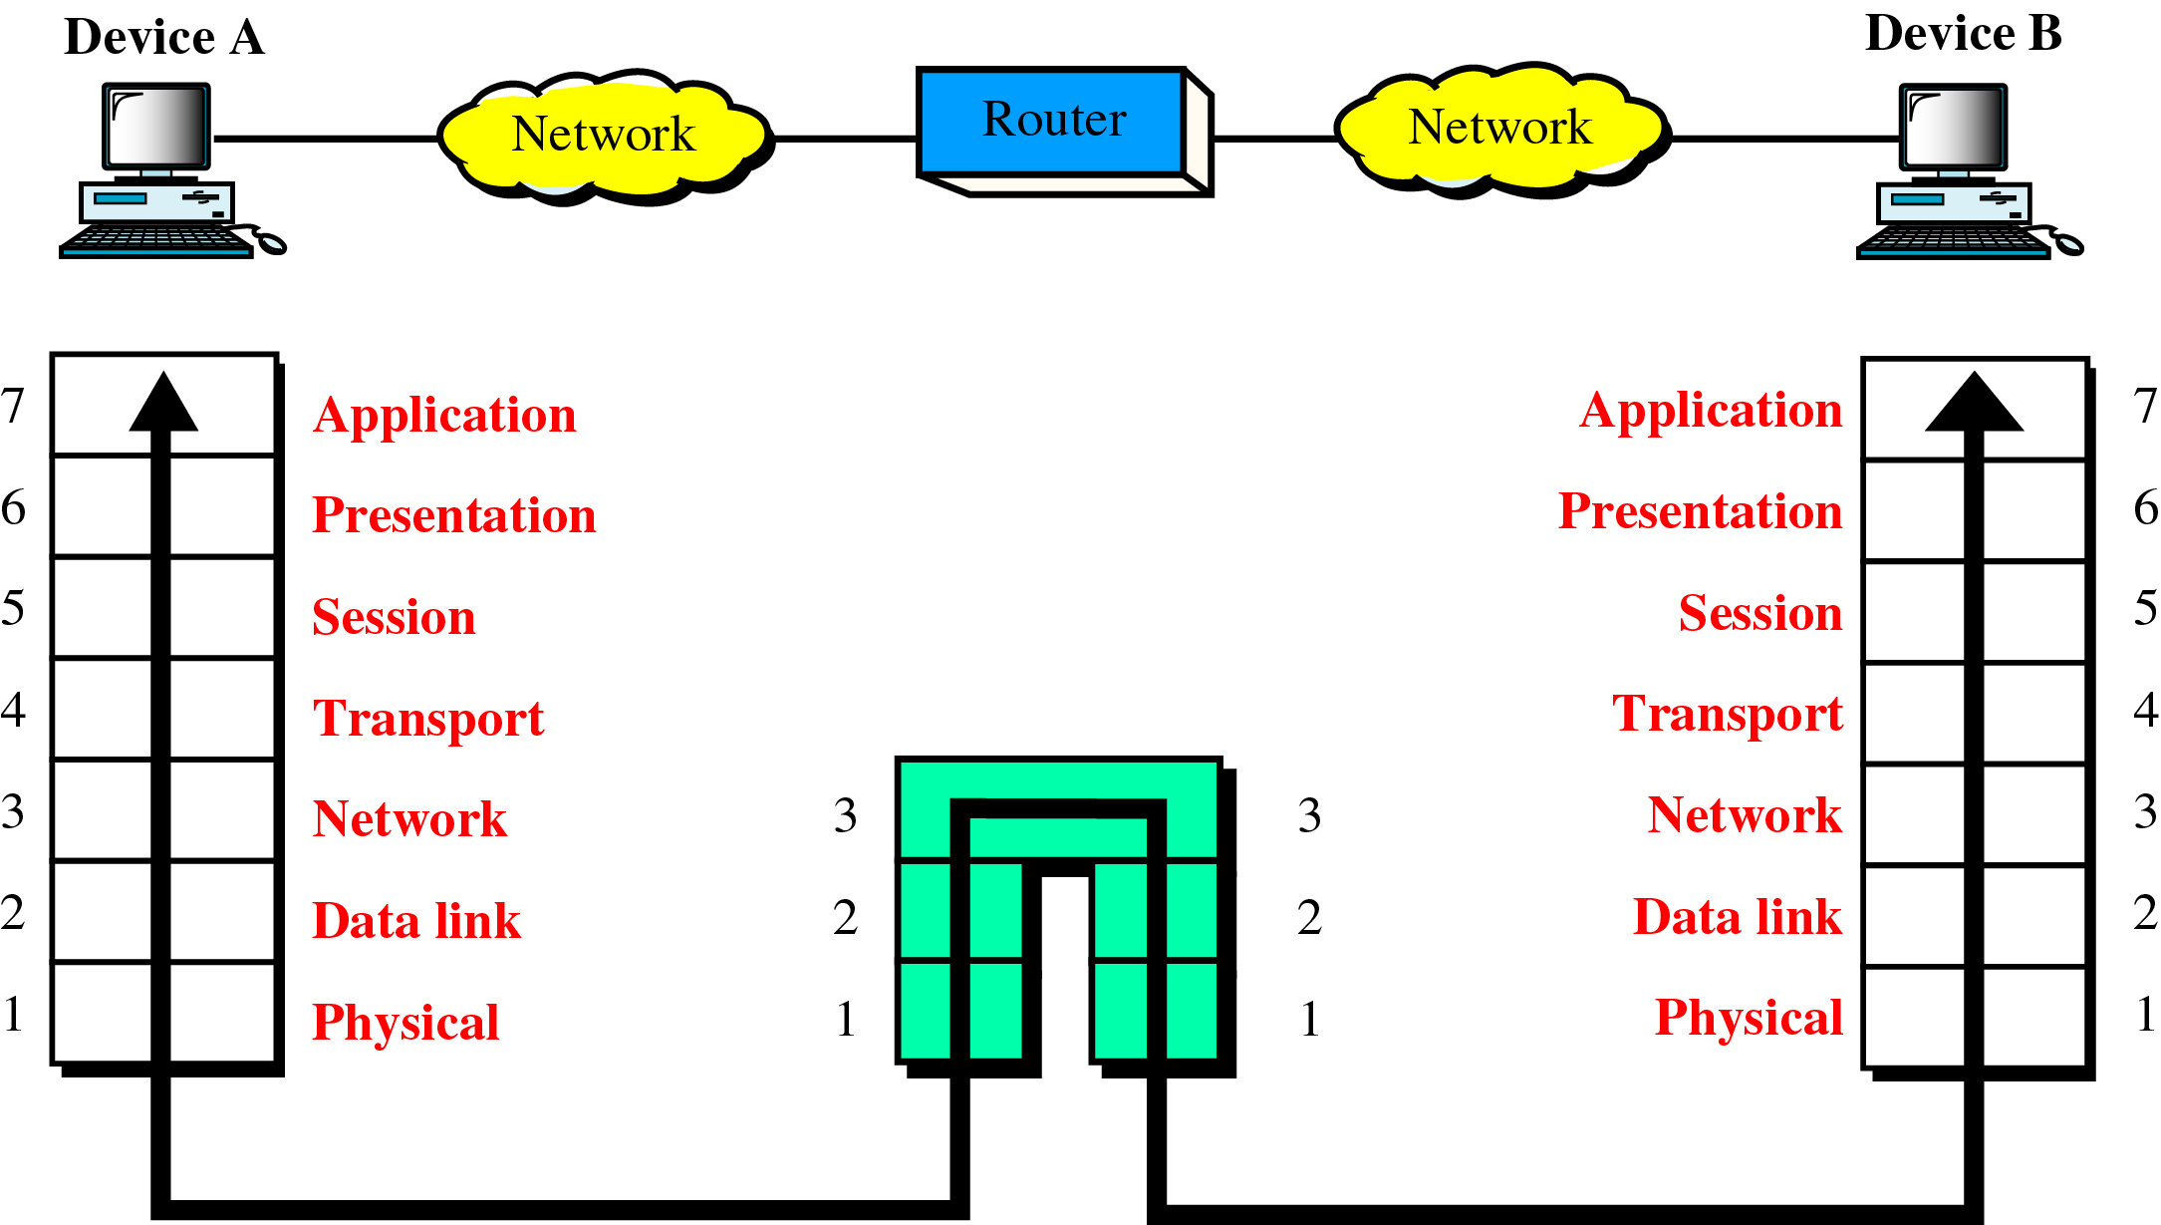
A Router in the OSI Model

Slide 16
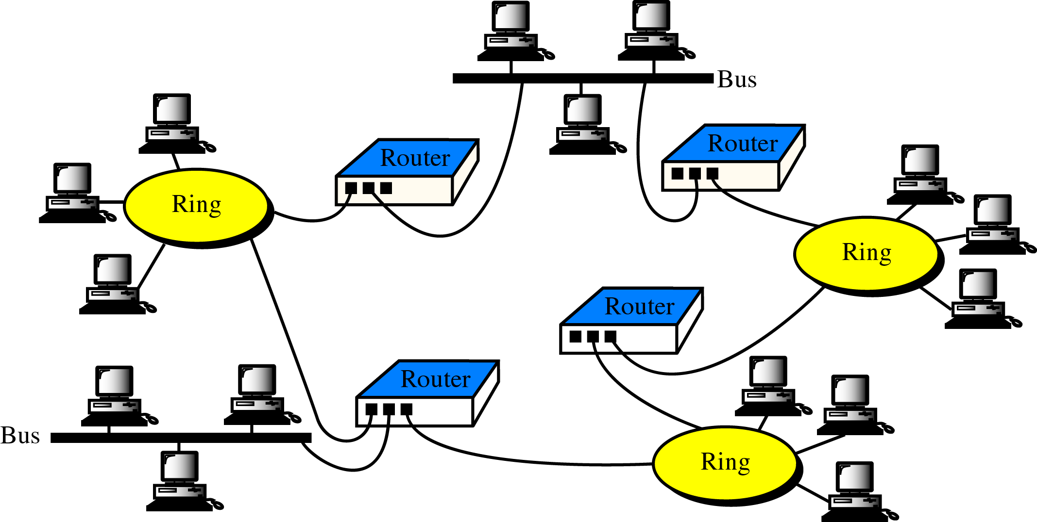
Routers in an Internet

Slide 17
In routing the term shortest can mean the smallest number of relays, it is called hop-count or the combination of many factors including shortest, cheapest, fastest, most reliable, and so on.

Slide 18
Routing concepts
Transmission mode
Nonadaptive versus adaptive routing
Packet lifetime

Slide 19
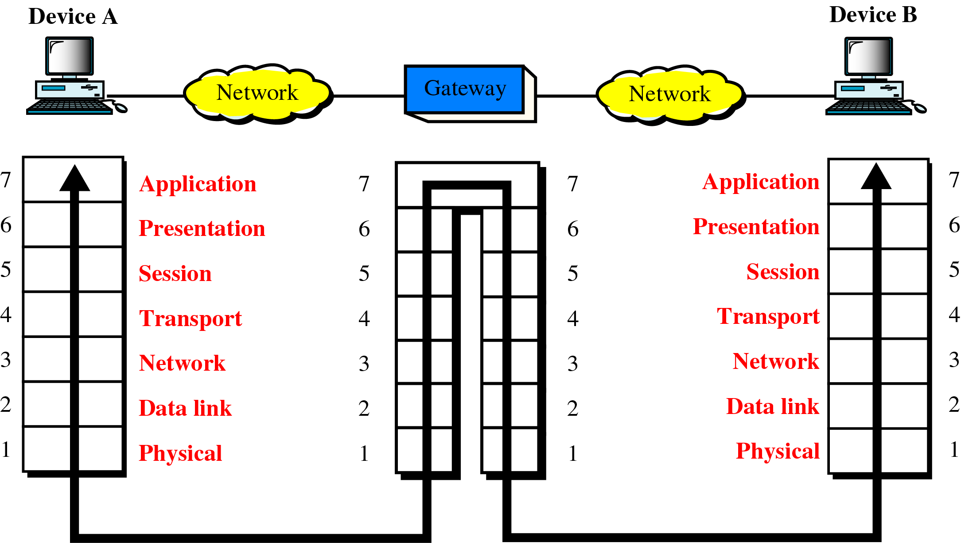
A Gateway in the OSI Model

Slide 20
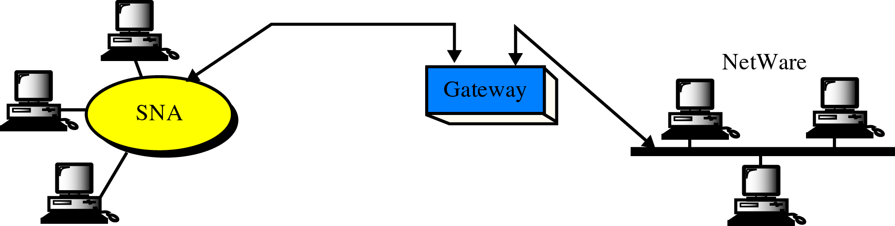
A Gateway

Slide 21
Other devices
Multiprotocol routers
Brouters
Switches (store-and-forward switch and cut-through switch)
Routing switch

Slide 22
Routing algorithms
Distance vector routing
Link state routing

Slide 23
Keys of distance vector routing
Knowledge about the whole network
Routing only to neighbors
Information sharing at regular intervals

Slide 24
Updating algorithm
If the advertised destination is not in the routing table, the router should add the advertised information to the table.
If the advertised destination is in the routing table,
a- if the next-hop field is the same, the router should replace the entry in the table with the advertised one

Slide 25
Continue updating algorithm
b- if the next-hop field is not the same,
i- if the advertised hop count is smaller than the one in the table, the router should replace the entry in the table with the new one.
ii- if the advertised hop count is not smaller (same or larger), the router should do nothing.

